Slide 1
CONTROL FLOW
Control Flow

Slide 2
Today’s Agenda
Topics:
Control Structures
sequence structure
selection structure
The if , if-else, nested-if statements , the ?: operator, the Switch statement
Repetition structure
Sentinel-Controlled Repetition
Counter-Controlled Repetition
The for, while, do-while statements
Branching Statements
The break and continue Statements, the return statement, exit
Reading:
Java how to program Late objects version (D & D)
Chapter 3 & Chapter 4
The Java Tutorials
Lesson: Language Basics: Control Flow Statements
https://docs.oracle.com/javase/tutorial/java/nutsandbolts/index.html
Welcome to Java for Python Programmers
http://interactivepython.org/courselib/static/java4python/index.html

Slide 3
1.Control Structures
Sequential execution
Statements in a program execute one after the other in the order in which they are written.
Transfer of control
Various Java statements, enable you to specify that the next statement to execute is not necessarily the next one in sequence.
All programs can be written in terms of only three control structures—
the sequence structure,
the selection structure and
the repetition structure.

Slide 4
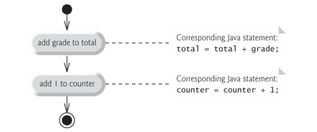
2.Sequence Structure
Sequence structure
Built into Java.
Unless directed otherwise, the computer executes Java statements one after the other in the order in which they’re written.
System.out.println("Hello"); System.out.println("World");
Hello
World

Slide 5
3.Selection Structure
Three types of selection statements.
if statement:
Performs an action, if a condition is true; skips it, if false.
Single-selection statement—selects or ignores a single action (or group of actions).
if…else statement:
Performs an action if a condition is true and performs a different action if the condition is false.
Double-selection statement—selects between two different actions (or groups of actions).
switch statement
Performs one of several actions, based on the value of an expression.
Multiple-selection statement—selects among many different actions (or groups of actions).

Slide 6
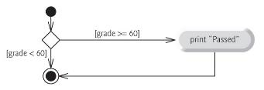
3.Selection Structure The if statement
if condition:
statement1
...
Python
if (condition) {
statement1;
...
}
if Single-Selection Statement
Python and Java are very similar
The statements in the consequent and each alternative are marked by curly braces ({}). When there is just one statement, the braces may be omitted.
Indentation: Optional, but recommended
Each Boolean expression is enclosed in parentheses.
Example:
If the condition is false, the Print statement is ignored, and the next pseudocode statement in order is performed.
Java

Slide 7
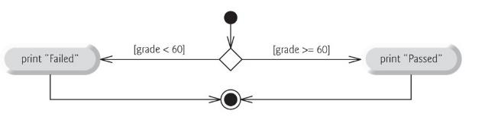
3.Selection Structure The if-else statement
if condition:
statement1
...
else:
statement2
...
Python
if…else Double-Selection Statement
specify an action to perform when the condition is true and another action when the condition is false.
Example:
if (condition) {
statement1;
...
} else {
statement2;
...
}
Only one statement in its body! Don’t have to use {}
if (condition)
statement1;
else
statement2;
several statements in the body,
must enclose the statements in braces {}.
i.e. to form a block

Slide 8
3.Selection Structure Nested if-else statements
L04Code.java
Nested if…else statements:
placing if…else statements inside other if…else statements
if (grade < 60) {
System.out.println('F');
} else if (grade < 70) {
System.out.println('D');
} else if (grade < 80) {
System.out.println('C');
} else if (grade < 90) {
System.out.println('B');
} else
System.out.println('A');
if grade < 60:
print 'F'
elif grade < 70:
print 'D'
elif grade < 80:
print 'C'
elif grade < 90:
print 'B'
else:
print 'A'
Java
Python
In a nested if-else statements, ensure that you test for all possible cases!

Slide 9

3.Selection Structure if-else Double-Selection Statement
L04Code.java
The Java compiler always associates an else with the immediately preceding if unless told to do otherwise by the placement of braces
The following code is not what it appears:
Beware! This nested if…else statement does not execute as it appears. The compiler actually interprets the statement as
To force the nested if…else statement to execute as it was originally intended, we must write it as follows:
if (x > 5) if (y > 5) System.out.println("x and y are > 5"); else System.out.println("x is <= 5");
if (x > 5) if (y > 5) System.out.println("x and y are > 5"); else System.out.println("x is <= 5");
if (x > 5) { if (y > 5) System.out.println("x and y are > 5"); } else System.out.println("x is <= 5");
‘{‘ and ‘}’

Slide 10
3.Selection Structure The ? : Operator
This operator consists of three operands and is used to evaluate Boolean expressions.
The goal of the operator is to decide which value should be assigned to the variable.
It is a ternary operator (takes three operands)
The operator is written as:
Operand to the left of the ? is a boolean expression
evaluates to a boolean value (true or false)
Second operand (between the ? and :) is the value if the boolean expression is true
Third operand (to the right of the :) is the value if the boolean expression evaluates to false.
It can be used in place of an if…else statement.
variable x = (expression) ? value if true : value if false

Slide 11
3.Selection Structure The ? : Operator - Examples
L04Code.java
int grade=60;
System.out.println(grade >= 60 ? "Passed" : "Failed");
Example 1:
Evaluates to the string "Passed" if the boolean expression grade >= 60 is true and to the string "Failed" if it is false.
Example 2:
Passed
int a, b;
a = 10;
b = (a == 1) ? 20: 30;
System.out.println( "Value of b is : " + b );
b = (a == 10) ? 20: 30;
System.out.println( "Value of b is : " + b );
Value of b is : 30
Value of b is : 20

Slide 12
3.Selection Structure The switch Statement
A switch statement allows a variable to be tested for equality against a list of values.
Each value is called a case, and the variable being switched on is checked for each case.
Variables: integers, convertable integers (byte, short, char) and strings
Value: must be the same data type, a constant or a literal.
When the variable being switched on is equal to a case, the statements following that case will execute until a break statement is reached.
Not every case needs to contain a break. If no break appears, the flow of control will fall through to subsequent cases until a break is reached.
A switch statement can have an optional default case, which must appear at the end of the switch.
The default case can be used for performing a task when none of the cases is true. No break is needed in the default case.

Slide 13

3.Selection Structure Example
L04Code.java
What would be the value of x after the following statements were executed?
int x = 10;
switch (x)
{
case 10:
x += 15;
case 12:
x -= 5;
break;
default:
x *= 3;
}
10
25
20
If no break appears, the flow of control will fall through from case 10 to case 12
x=20

Slide 14
Exercise 1
What is the output if grade is “B”, “C”, “D”, “E”,“F”? Rewrite the program
char grade = 'B';
switch(grade) {
case 'A' :
System.out.println("Excellent!");
break;
case 'B' :
case 'C' :
System.out.println("Well done");
break;
case 'D' :
System.out.println("You passed");
case 'F' :
System.out.println("Better try again");
break;
default :
System.out.println("Invalid grade");
}
System.out.println("Your grade is " + grade);

Slide 15
3.Selection Structure Multiple-Selection Statement
Note:
If a match occurs, the program executes that case’s statements.
switch does not provide a mechanism for testing ranges of values—every value must be listed in a separate case label.
switch differs from other control statements in that it does not require braces around multiple statements in a case.
Without break, the statements for a matching case and subsequent cases execute until a break or the end of the switch is encountered. This is called “falling through.”
If no match occurs between the controlling expression’s value and a case label, the default case executes.
If no match occurs and there is no default case, program control simply continues with the first statement after the switch.

Slide 16
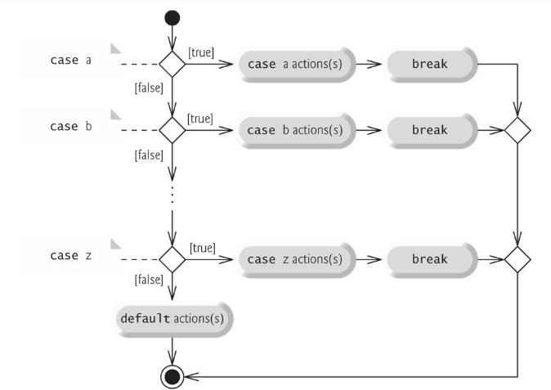
3.Selection Structure Multiple-Selection Statement
Example:

Slide 17
3.Selection Structure Good programming Practice
In a switch statement, ensure that you test for all possible values of the controlling expression
Provide a default case in switch statements. This forces you on the need to process exceptional conditions
Although each case and the default case in a switch can occur in any order, place the default case last. When the default case is listed last, the break for that case is not required.

Slide 18
4.Repetition Structure
It is also called iteration statements or looping statements
Perform statements repeatedly while a loop-continuation condition remains true.
while and for statements perform the action(s) in their bodies zero or more times
if the loop-continuation condition is initially false, the body will not execute.
The do…while statement performs the action(s) in its body one or more times.

Slide 19
4.Repetition Structure The while Statement
statementsBeforeLoop;
while( condition ) {
statement_1;
...
statement_n;
}
statementsAfterLoop;
The while repetition statement
repeats an action while a condition remains true.
The repetition statement’s body may be a single statement or a block.
Eventually, the condition will become false. At this point, the repetition terminates, and the first statement after the repetition statement executes.
Example:
Insert a coin
Insert a coin
Insert a coin
Insert a coin
int numberOfCoins = 4;
while( numberOfCoins > 0 ) {
numberOfCoins--;
System.out.println("Insert a coin");
}

Slide 20
4.Repetition Structure Sentinel-Controlled Repetition
It is often called indefinite repetition because the number of repetitions is not known before the loop begins executing.
A special value called a sentinel value (also called a signal/dummy/flag value) can be used to indicate “end of data entry.”
Program logic for sentinel-controlled repetition
Reads the first value before reaching the loop.
If the condition of the loop is false, so the body of the loop does not execute
If the condition is true, the body begins execution and processes the input.
Then the loop body inputs the next value from the user before the end of the loop.

Slide 21
4.Repetition Structure Sentinel-Controlled Repetition
Example: Develop a class-averaging program that processes grades for an arbitrary number of students each time it’s run.
Steps:
Initialize variables (initialize total, count to zero)
Input, sum and count the quiz grades
Calculate and print the class average
For step 2: Input, sum and count the quiz grades
It requires a repetition to successively input each grade.
We do not know in advance how many grades will be entered, so we’ll use sentinel-controlled repetition.
Prompt the user to enter the first grade Input the first grade (possibly the sentinel)
while the user has not yet entered the sentinel Add this grade into the running total Add one to the grade counter Prompt the user to enter the next grade

Slide 22
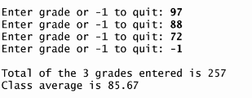
4.Repetition Structure Example
L04Code02.java
Develop a class-averaging program that processes grades for an arbitrary number of students each time it’s run.
sentinel-controlled: when grade is -1
Scanner input = new Scanner(System.in);
int total = 0, gradeCounter = 0;
System.out.print("Enter grade or -1 to quit: ");
int grade = input.nextInt();
while (grade != -1) {
total += grade;
gradeCounter += 1;
System.out.print("Enter grade or -1 to quit: ");
grade = input.nextInt();
}

Slide 23
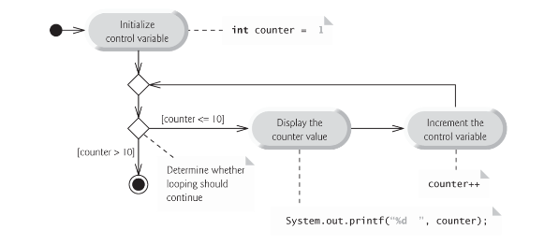
4.Repetition Structure Counter-Controlled Repetition
A variable called a counter (or control variable) controls the number of times a set of statements will execute.
It is often called definite repetition, because the number of repetitions is known before the loop begins executing
Counter-controlled repetition requires
the initial value of the control variable
the increment by which the control variable is modified each time through the loop (also known as each iteration of the loop)
the loop-continuation condition that determines if looping should continue.

Slide 24
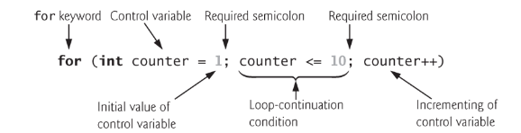
4.Repetition Structure Counter-Controlled Repetition: for
Specifies the counter-controlled-repetition in a single line of code
When the for statement begins executing, the control variable is declared and initialized.
Next, the program checks the loop-continuation condition, which is between the two required semicolons.
If the condition initially is true, the body statement executes.
After executing the loop’s body, the program increments the control variable in the increment expression.
Then the loop-continuation test is performed again to determine whether the program should continue with the next iteration of the loop.
The general form:
for (initialization; loopContinuationCondition; increment) statement

Slide 25
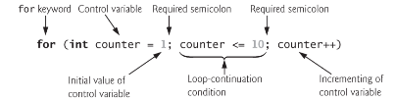
4.Repetition Structure Counter-Controlled Repetition: for
If the loop-continuation condition is initially false, the program does not execute the for statement’s body.
If the initialization expression in the for header declares the control variable, the control variable can be used only in that for statement.
The two semicolons in the for header are required.
All three expressions in a for header are optional. But if …
loopContinuationCondition is omitted, thus creating an infinite loop.
initialization is omitted only if your program initializes the control variable before the loop.
The initialization and increment can be comma-separated lists that enable you to use multiple initialization or multiple increment.
The increment of a for statement may be negative, in which case it’s a decrement, and the loop counts downward.

Slide 26
4.Repetition Structure Examples
Initialization, loop-continuation condition, increment can be comma-separated lists of expressions
Example 1
Example 2
loop-continuation condition
number=22
total=110
int number = 2, total=0;
for(; number <= 20; total += number, number += 2)
; // empty statement
System.out.println("number=" + number);
System.out.println("total=" + total);
total = 0;
for (int n = 2; n <=20; n +=2 ) {
total += n;
System.out.println(n);
}
//System.out.println(n);
System.out.println("total=" + total);
calculate total in the body
total=110
“n” is only visible within the loop

Slide 27
4.Repetition Structure Counter-Controlled Repetition: while
The for statement often can be represented with an equivalent while statement as follows:
Typically, for statements are used for counter-controlled repetition and while statements for sentinel-controlled repetition.
initialization;
while (loopContinuationCondition) { statement increment; }
total=0;
number=2;
while (number <= 20) {
total += number;
number +=2;
}
System.out.println("total=" + total);

Slide 28
4.Repetition Structure The do-while Statements
The do…while repetition statement is similar to the while statement.
In the while, the program tests the loop-continuation condition at the beginning of the loop, before executing the loop’s body; if the condition is false, the body never executes.
The do…while statement tests the loop-continuation condition after executing the loop’s body; therefore, the body always executes at least ONCE.
When a do…while statement terminates, execution continues with the next statement in sequence.
Syntax:
do {
statement(s)
} while (expression);

Slide 29
4.Repetition Structure Examples
1 2 3 4 5 6 7 8 9 10 END-11
counter = 1;
do {
System.out.printf("%d ", counter);
++counter;
} while (counter <= 10);
System.out.println("END-"+counter);
Example 1:
Example 2:
Example 3:
counter = 100;
do {
System.out.printf("%d ", counter);
++counter;
} while (counter <= 10);
System.out.println("END-"+counter);
100 END-101
once
counter = 100;
while (counter <=10) {
System.out.printf("%d ", counter);
++counter;
}
System.out.println("END-"+counter);
ZERO
END-100

Slide 30
Exercise 2
What will be the value of x after the following code is executed?
int x = 10;
while (x < 100); { //note: there is a ';'
x += 10;
}
System.out.println(x);

Slide 31
5.Branching Statements The break statement
L04Code03.java
The break statement used to terminate the innermost switch, for, while, or do-while statement;
i.e. causes immediate exit from that statement.
Execution continues with the first statement after the control statement.
Common uses of the break statement are to escape early from a loop or to skip the remainder of a switch.
Example:
1 2 3 4
Broke out of loop at count=5
Loop 10 times
int count;
for (count=1; count<=10; count++) {
if (count == 5)
break;
System.out.printf("%d ",count);
}
System.out.printf("%nBroke out of loop at count=%d%n", count);

Slide 32
5.Branching Statements The continue statement
The continue statement skips to the end of the innermost loop's body and evaluates the boolean expression that controls the loop.
i.e. skips the remaining statements of this iteration in the loop body and proceeds with the next iteration of the loop.
Example:
1 2 3 4 6 7 8 9 10
Used continue to skip printing 5
int count;
for (count=1; count<=10; count++) {
if (count == 5)
continue;
System.out.printf("%d ",count);
}
System.out.printf("%nUsed continue to skip printing 5%n");
Skipped at 5

Slide 33
5.Branching Statements for … continue Vs while … continue
In a for statement, the increment expression executes, then the program evaluates the loop-continuation test.
in while and do…while statements, the program evaluates the loop-continuation test immediately after the continue statement executes
if the increment appears after the continue statement, the increment statement is not executed. => infinite loop
for (; i <4; i++){
if (i == 2)
continue;
System.out.printf("%d ",i);
}
System.out.printf("%nEND_EXAMPLE1 %d%n", i);
0 1 3
END_EXAMPLE1 4
while (j<4) {
if (j == 2)
continue;
System.out.printf("%d ",j);
j++;
}
System.out.printf("%nEND_EXAMPLE2 %d%n", j);
0 1 ...
Increment step is NOT executed … infinite loop

Slide 34
5.Branching Statements Nested Loops & break
L04Code04.java
i | outer | j | inner | i+j | output
0 | 0<3 | 0 | 0<3 | 0 | *
 |  | …
 |  | 3 | False |  | -
1 |  | 0 | 0<3 | 1 | *** *
 |  | 1 | 1<3 | 2 | *** **
 |  | 2 | 2<3 | 3=3 break
2 |  | 0 | 2<3 | 2 | *** ** *
 |  | 1 | 1<3 | 3=3 break
3 | False
It is used to terminate the innermost switch, for, while, or do-while statement
Example:
int row = 3;
for( int i = 0; i < row; i ++) {
for (int j = 0; j < row; j++) {
if ( i+j >= row )
break;
System.out.print("*");
}
System.out.println();
}
***
**
*

Slide 35
5.Branching Statements The return statement
The return statement is used to exit from the current method;
The flow of control returns to the statement that follows the original method call.
The return statement has two forms:
return;
exits the current method
return variableName;
returns a value
Note: the data type of the value returned by return must match the type of the method's declared return value.
int row = 4;
for (int i= 1; i <= row; i++ ) {
if( i % 2 == 0)
return;
System.out.println("i = " + i );
}
i | C | output
1 | 1<=4 | Print “i=1”
 | 2<=4 | Return from the method
i=1

Slide 36
5.Branching Statements The exit method
If you have a program situation where it is pointless to continue execution you can terminate the program with the System.exit(n) method
n is often used to identify if the program ended normally or abnormally
n is conventionally 0 for normal termination and non-zero for abnormal termination
if ( i < 3)
System.exit(0);

Slide 37
Exercise 3
Complete the code which finds the average of all the even whole numbers between 10 and 15
int firstNumber = 10, lastNumber = 15;
int total = 0, count=0;
//set up the for loop
// if i is an even number, add the total, increment the count
if (count != 0) {
double average = (double) total/count;
System.out.printf("Average is %.2f%n", average);
}

Slide 38
Exercise 4
Complete the code which reads THREE rows of numbers from the User. Enter -1 to end each row
System.out.println("Enter 3 rows of digits('-1' to end each row):");
for (int i=0; i < 3; i++) {
for (int j=0; ; j++) {
____________________
if (num == ___________) {
rows += "\n";
_____
}
rows = rows + num + " ";
}
}
System.out.println("\nRows of digits\n" + rows);
4
6
7
-1
2
3
-1
1
4
5
-1
Rows of digits
4 6 7
2 3
1 4 5

